Slide 1
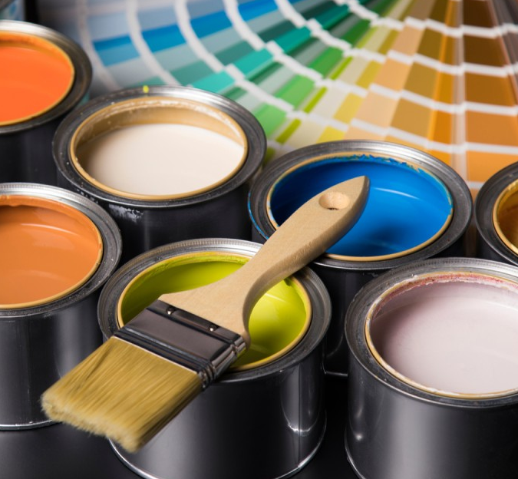


Paint and finishes play a crucial role in creating and maintaining a fresh and inviting store, protecting against mold and mildew, and complying with food safety regulations.
Sherwin Williams provides the most comprehensive lineup of coatings and materials with premium products that will help set your store apart with quality and consistency.
With 4,400+ store locations coupled with performance and service guarantees, Sherwin Williams is well-positioned to meet business needs across the US and support all your finish and coating needs.
Program Benefits
  Interior and Exterior Paint & Coatings
  Equipment & Supplies
  Roof & Floor Coatings
  Commercial Wallpaper
  Commercial Floorcovering
Topco Pricing on Paints, Coatings & Stains
    30% off Paints & Stains
    15% off Sundries & Supplies
  Single National Account contact
  Easy online ordering
  In-store purchasing options
  Customized color design services
  ColorSnap® precision color matching
  Local contractor referral service

